Slide 1
MSIS 618 Database Management
Example Final Project
By Andy Du

Slide 2
Step 1: Learn the Business We Want to Track in the Database Step 2: Database Design [Step2.1] Data Model [Step2.2] (Physical) Database Design [Step 2.3] Normalization
How to Complete a Database Project
Step 4: Implement the Database Design in MySQL Step 5: Populate Created Tables with Data (Insert Statement, or direct data import) Step 6: Create Data Reports by SQL SELECT Statements

Slide 3
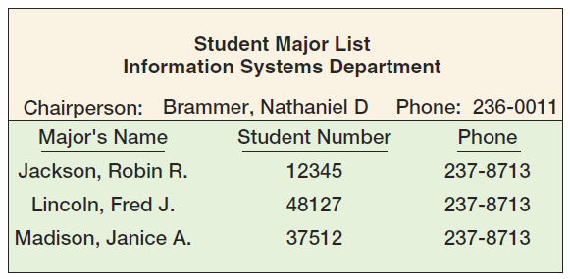
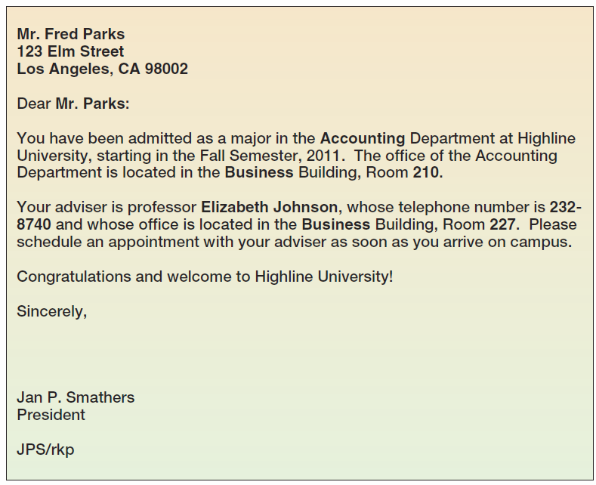
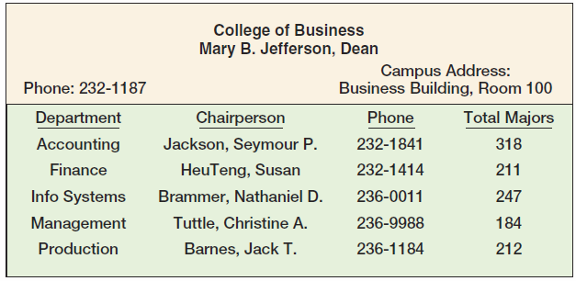
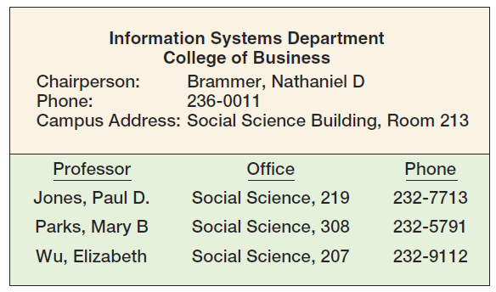
Step 1: Learn the Business Reality We Want to Track in the Database
Assuming that we are contracted to design a simple personnel database for a university named Highline University. Here we are handed over a bunch of reports that the university is current using (or wants to use), and we need to somehow capture the information in these reports in our database.

Slide 4
Step 2: Database Design
[Step2.1] Data Model

Slide 5
Highline University The College Report

Slide 6
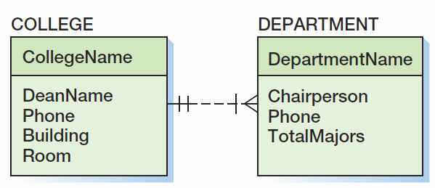
Highline University First Data Model

Slide 7
Highline University The Department Report

Slide 8
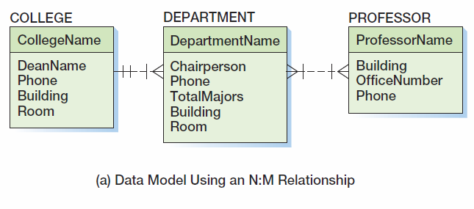
Highline University Second Data Model
IF a professor can be appointed to many departments (and of course one department will have many professors)

Slide 9
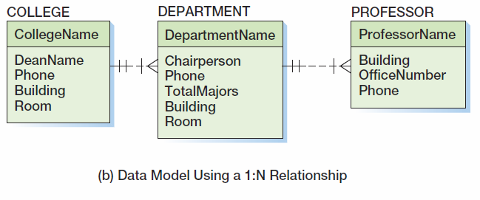
Highline University Second Data Model
IF a professor can be appointed to only ONE department

Slide 10
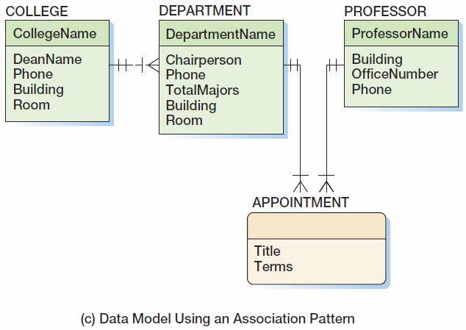
Highline University Second Data Model
IF a professor can be appointed to many departments and his/her titles and terms are different in different departments

Slide 11
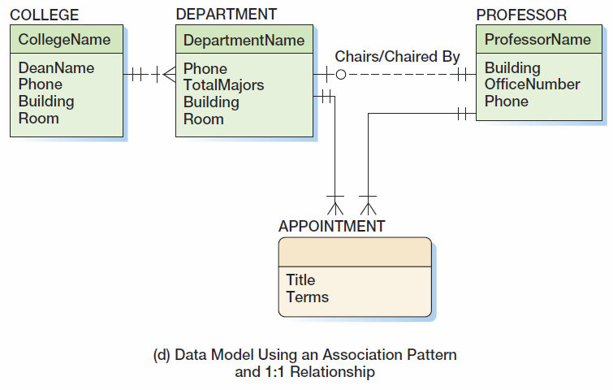
Highline University Second Data Model
Well, a chairperson is also a professor, and one department can have only one chairperson.

Slide 12
Highline University The Department Student Report

Slide 13
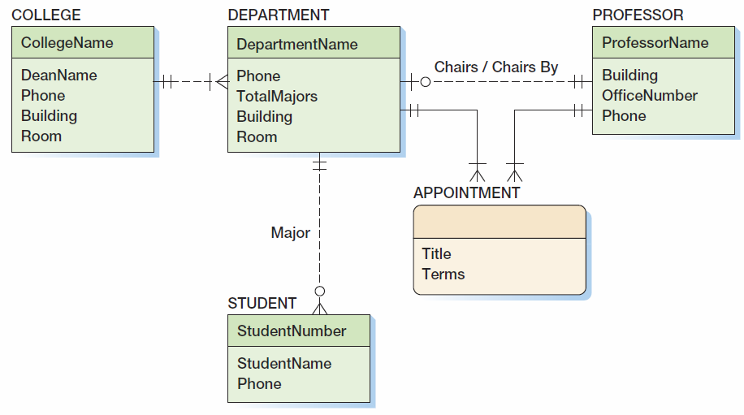
Highline University Third Data Model

Slide 14
Highline University Sample Student Acceptance Letter

Slide 15
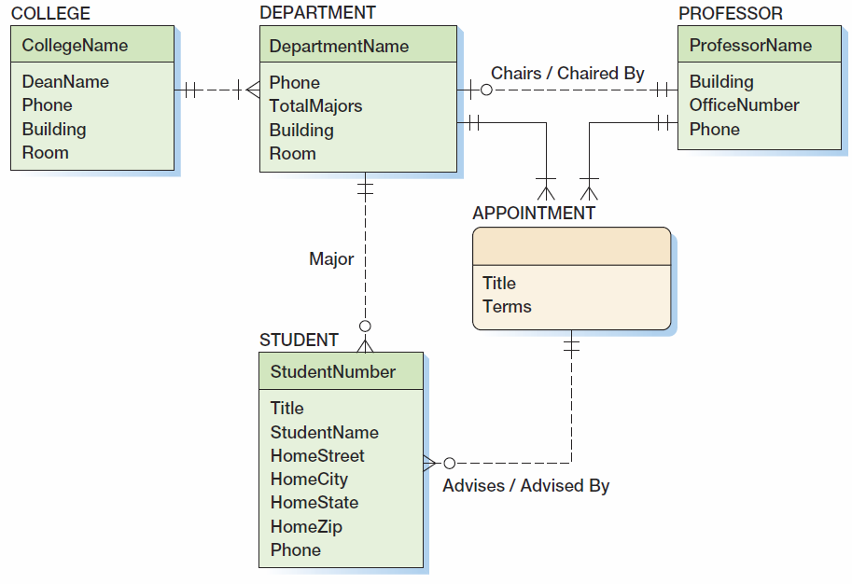
Highline University Fourth (and Final) Data Model

Slide 16
[Step2.2] Convert the Data Model into Actual Database Design

Slide 17
[Step2.2] Cont’d (Detailed Physical Database Design)

Slide 18
[Step3] Check the Quality of our Database Design; Normalize if needed
COLLEGE (CollegeName, DeanName, Phone, Building, Room)
DEPARTMENT (DepartmentName, Phone, TotalMajors, Building, Room, CollegeName, ChairpersonName)
Where DEPARTMENT.CollegeName MUST Exist in COLLEGE.CollegeName
Where DEPARTMENT.ChairpersonName MUST Exist in PROFESSOR.ProfessorName
PROFESSOR (ProfessorName, Building, OfficeNumber, Phone)
APPOINTMENT (AppointmentID, DepartmentName, ProfessorName, Title Term)
Where APPOINTMENT. DepartmentName MUST Exist in DEPARTMENT.DepartmentName
Where APPOINTMENT.ProfessorName MUST Exist in PROFESSOR.ProfessorName
STUDENT (StudentNumber, Title, StudentName, HomeStreet, HomeCity, HomeState, HomeZip, Phone, DepartmentName, AppointmentID)
Where STUDENT. DepartmentName MUST Exist in DEPARTMENT.DepartmentName
Where STUDENT. AppointmentID MUST Exist in APPOINTMENT. AppointmentID

Slide 19
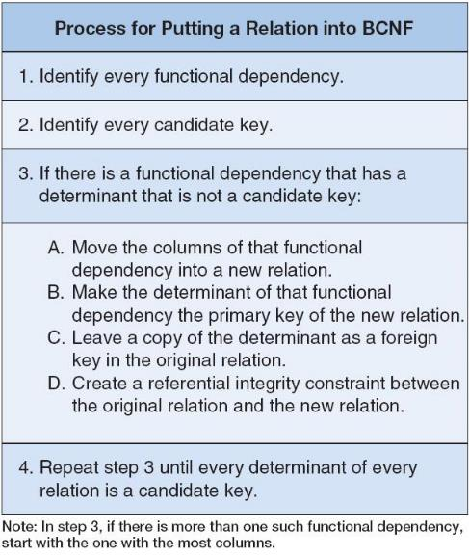
[Step3] Check the Quality of our Database Design; Normalize if needed

Slide 20
Step 4: Implement the Database Design in MySQL

Slide 21
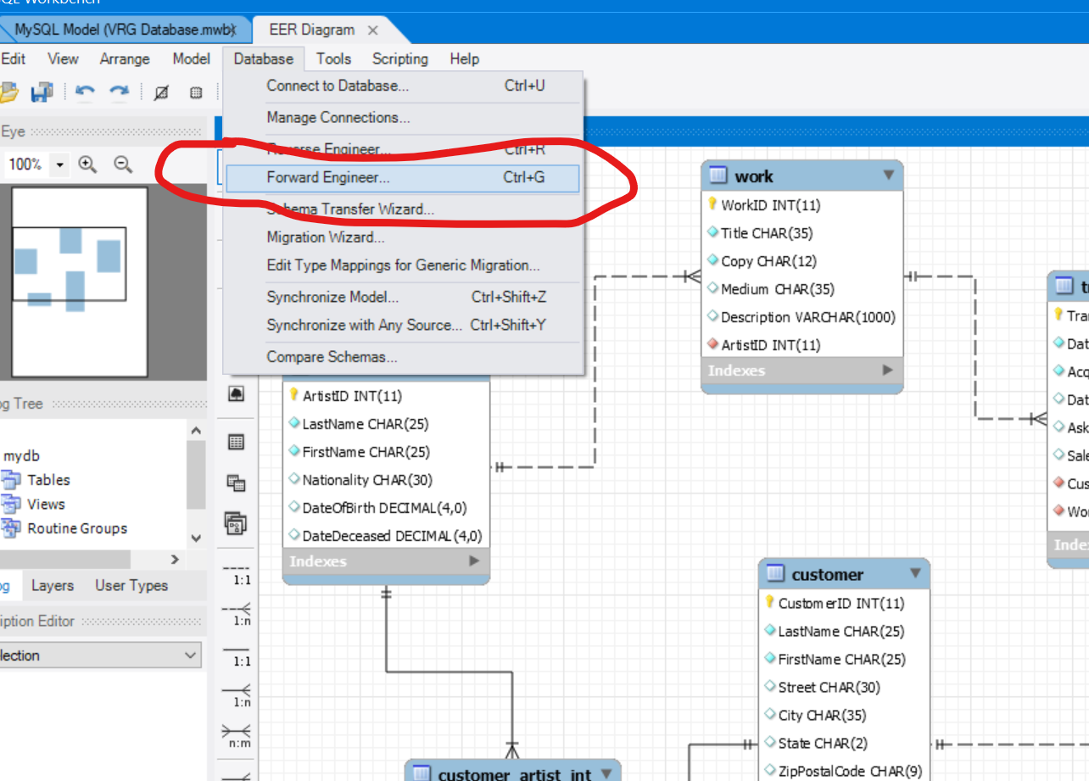
It is OK to use MySQL Workbench’s forward engineering feature

Slide 22
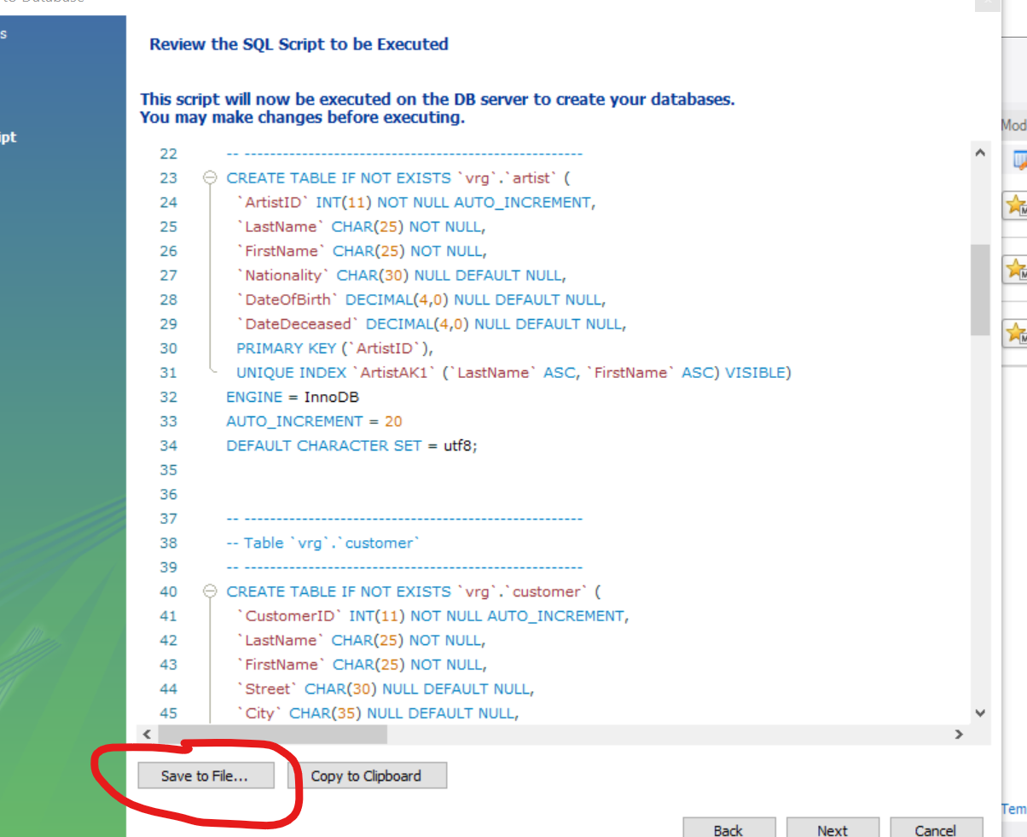
If using forward engineering, make sure you save the computer-generated codes and include them in your submission
Computer-generated codes during forward engineering do NOT always work.
If the generated codes do not work, try to fix them manually, or start over the E-R diagram and then redo forward engineering

Slide 23
Step 5: Populate Created Tables with Data (Insert Statement, or direct data import)

Slide 24
Simplify Data Input to MySQL

Slide 25

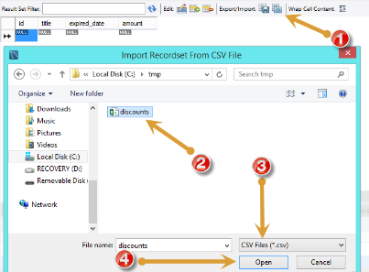
MySQL – Bulk Data Entry (1)
Open table to which the data is loaded. Click Import button, choose a CSV file and click Open button
https://www.mysqltutorial.org/import-csv-file-mysql-table/

Slide 26
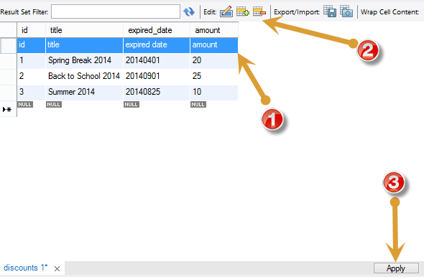
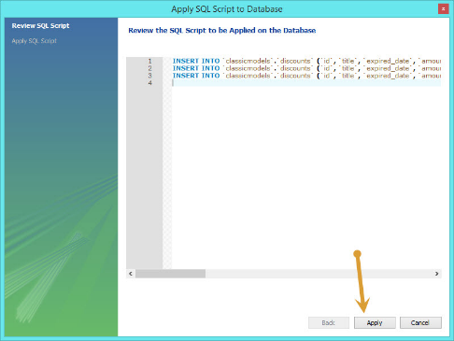
MySQL – Bulk Data Entry (2)
Review the data; edit them if necessary; and then click Apply button.
https://www.mysqltutorial.org/import-csv-file-mysql-table/

Slide 27
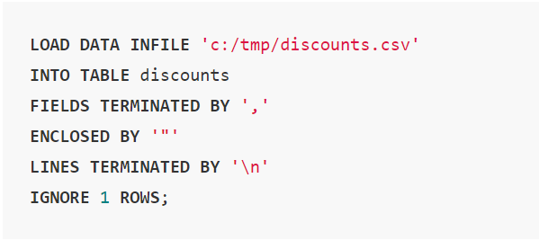
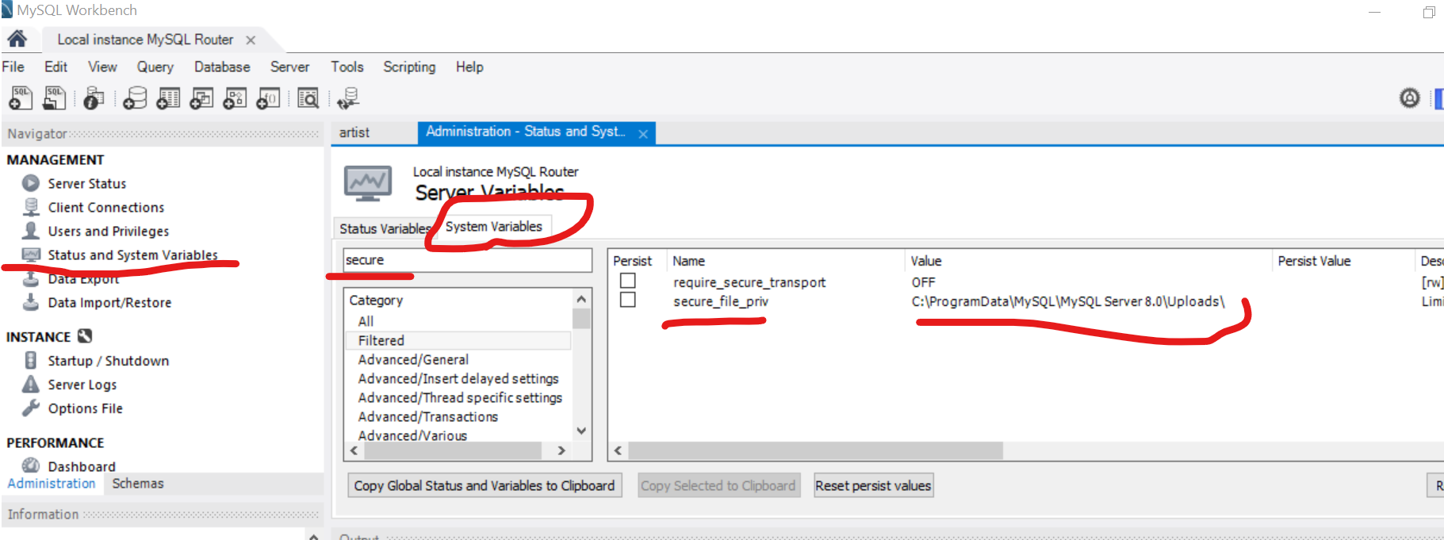
MySQL – Bulk Data Entry (3)
Can also be done programmatically
The table, “discounts” in this example, must be created first and must match the data structure in the csv data file
By default, MySQL only accepts file import from a given folder, which can be changed here.
Can not directly import Excel file (Excel files can be easily saved as csv files)
https://www.mysqltutorial.org/import-csv-file-mysql-table/

Slide 28
Step 6: Create Data Reports by SQL SELECT Statements

Slide 29
Tips for Your Final Project
Read the Project Guideline VERY carefully
Do it as if you are actually building a database for real-life use
Follow the standards as WE Learned in class (especially for E-R diagram and normalization)
Keep the Project Scope Small
Write Project Report Professionally; Explain what you want to do, what you did, and why you did it that way
Start Early; Ask for advice if struck
Submit (whatever you could finish) ON TIME

